Slide 1
Naive Bayes

Slide 2
Naïve Bayes
Naive Bayes is a probabilistic machine learning algorithm based on the Bayes Theorem, used in a wide variety of classification tasks.
Typical applications include filtering spam, classifying documents, sentiment prediction etc.
It is based on the works of Rev. Thomas Bayes (1702–61) and hence the name.

Slide 3
But why is it called Naïve?
The name naïve is used because it assumes the features that go into the model is independent of each other. That is changing the value of one feature, does not directly influence or change the value of any of the other features used in the algorithm.

Slide 4
But why is it so popular?
Because there is a significant advantage with NB. Since it is a probabilistic model, the algorithm can be coded up easily and the predictions made real quick. Real-time quick. Because of this, it is easily scalable and is traditionally the algorithm of choice for real-world applications (apps) that are required to respond to user’s requests instantaneously.

Slide 5
Naïve bayes
But before go into Naive Bayes there is a need to understand:
What is ‘Conditional Probability’ ?
What is the ‘Bayes Rule’?

Slide 6
What is ‘Conditional Probability’ ?
when you say the conditional probability of A given B, it denotes the probability of A occurring given that B has already occurred.
Mathematically, Conditional probability of A given B can be computed as: P(A|B) = P(A AND B) / P(B)

Slide 7
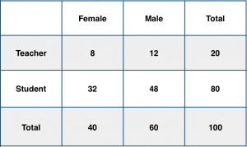
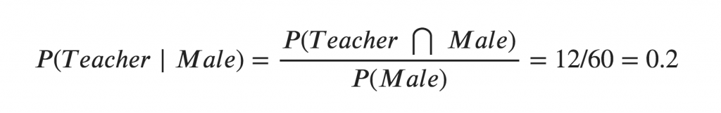
Example
Consider a school with a total population of 100 persons. These 100 persons can be seen either as ‘Students’ and ‘Teachers’ or as a population of ‘Males’ and ‘Females’.
With below tabulation of the 100 people, what is the conditional probability that a certain member of the school is a ‘Teacher’ given that he is a ‘Man’?
Conditional probability P(Teacher | Male) = 12 / 60 = 0.2.

Slide 8
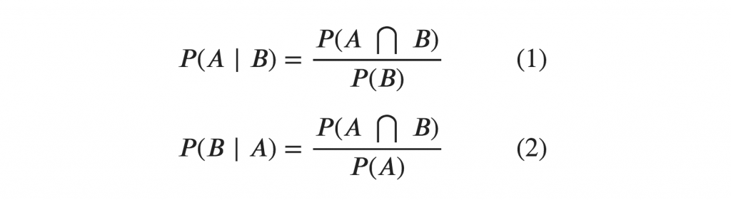
This can be represented as the intersection of Teacher (A) and Male (B) divided by Male (B). Likewise, the conditional probability of B given A can be computed. The Bayes Rule that we use for Naive Bayes, can be derived from these two notations.

Slide 9
The Bayes Rule
The Bayes Rule is a way of going from P(X|Y), known from the training dataset, to find P(Y|X).
For observations in test or scoring data, the X would be known while Y is unknown. And for each row of the test dataset, you want to compute the probability of Y given the X has already happened.
What happens if Y has more than 2 categories? we compute the probability of each class of Y and let the highest win.

Slide 10
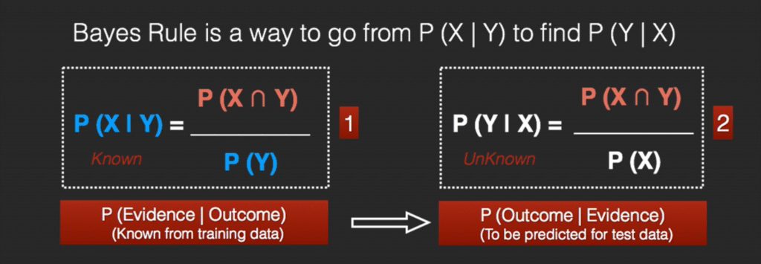
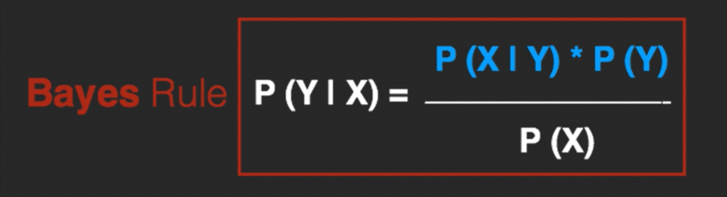

Slide 11
The Naive Bayes
The Bayes Rule provides the formula for the probability of Y given X. But, in real-world problems, you typically have multiple X variables.
When the features are independent, we can extend the Bayes Rule to what is called Naive Bayes.
It is called ‘Naive’ because of the naive assumption that the X’s are independent of each other. Regardless of its name, it’s a powerful formula.

Slide 12
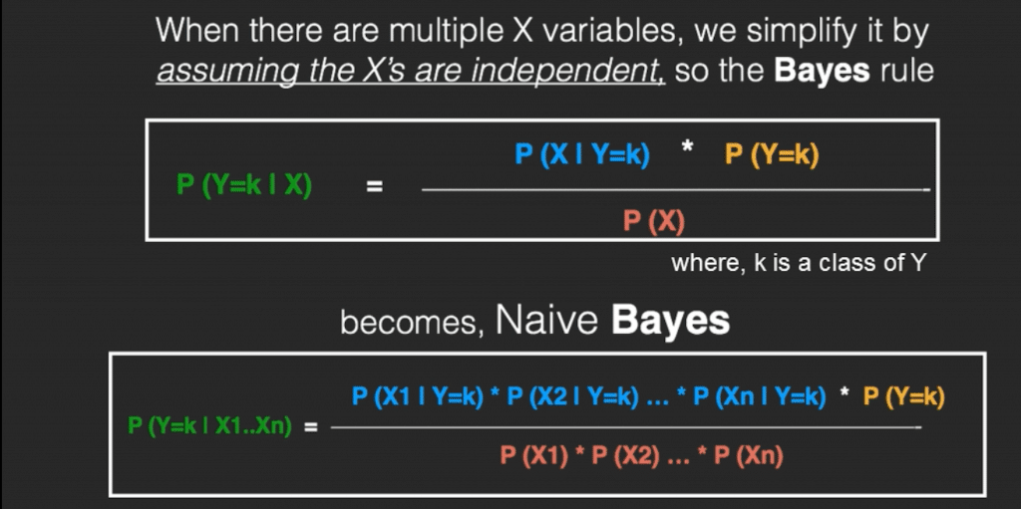

Slide 13
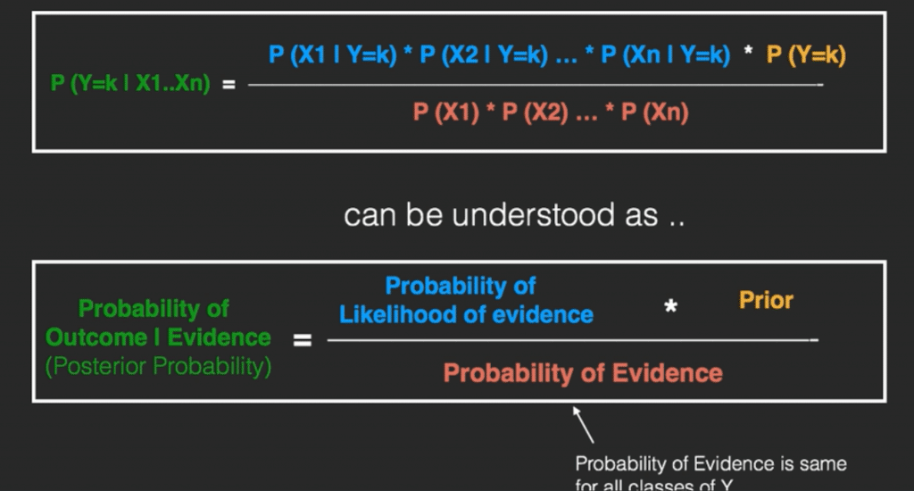

Slide 14
Example
Say you have 1000 fruits which could be either ‘banana’, ‘orange’ or ‘other’. These are the 3 possible classes of the Y variable.
Long
Sweet
Yellow

Slide 15
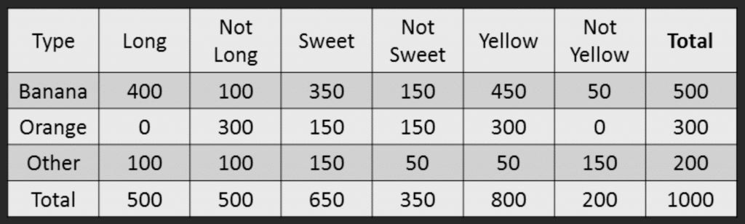
So the objective of the classifier is to predict if a given fruit is a ‘Banana’ or ‘Orange’ or ‘Other’ when only the 3 features (long, sweet and yellow) are known.
Let’s say you are given a fruit that is: Long, Sweet and Yellow, can you predict what fruit it is?
This is the same of predicting the Y when only the X variables in testing data are known. Let’s solve it by hand using Naive Bayes.
The idea is to compute the 3 probabilities, that is the probability of the fruit being a banana, orange or other. Whichever fruit type gets the highest probability wins.

Slide 16
Step 1: Compute the ‘Prior’ probabilities for each of the class of fruits.
That is, the proportion of each fruit class out of all the fruits from the population.
For this case, let’s compute from the training data. Out of 1000 records in training data, you have 500 Bananas, 300 Oranges and 200 Others. So the respective priors are 0.5, 0.3 and 0.2.
P(Y=Banana) = 500 / 1000 = 0.50
P(Y=Orange) = 300 / 1000 = 0.30
P(Y=Other) = 200 / 1000 = 0.20

Slide 17
Step 2: Compute the probability of evidence that goes in the denominator.
This is nothing but the product of P of Xs for all X. This is an optional step because the denominator is the same for all the classes and so will not affect the probabilities.
P(x1=Long) = 500 / 1000 = 0.50
P(x2=Sweet) = 650 / 1000 = 0.65
P(x3=Yellow) = 800 / 1000 = 0.80

Slide 18
Step 3: Compute the probability of likelihood of evidences that goes in the numerator.
It is the product of conditional probabilities of the 3 features. If you refer back to the formula, it says P(X1 |Y=k). Here X1 is ‘Long’ and k is ‘Banana’. That means the probability the fruit is ‘Long’ given that it is a Banana. In the above table, you have 500 Bananas. Out of that 400 is long. So, P(Long | Banana) = 400/500 = 0.8.
Probability of Likelihood for Banana (done it for Banana alone)
P(x1=Long | Y=Banana) = 400 / 500 = 0.80
P(x2=Sweet | Y=Banana) = 350 / 500 = 0.70
P(x3=Yellow | Y=Banana) = 450 / 500 = 0.90
So, the overall probability of Likelihood of evidence for Banana = 0.8 * 0.7 * 0.9 = 0.504

Slide 19
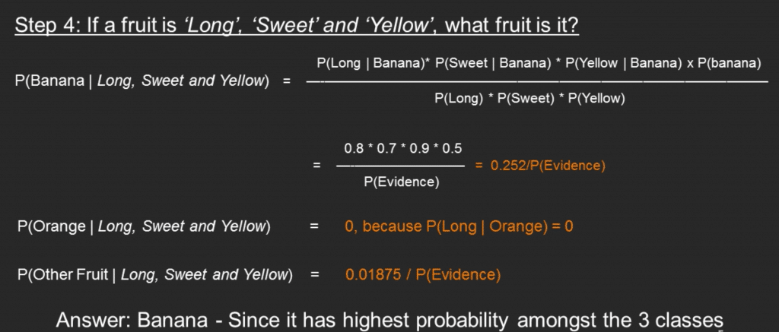
Step 4: Substitute all the 3 equations into the Naive Bayes formula, to get the probability that it is a banana.
Similarly, the probabilities for ‘Orange’ and ‘Other fruit’ can be computed. The denominator is the same for all 3 cases, so it’s optional to compute.
Clearly, Banana gets the highest probability, so that will be our predicted class.

Slide 20
What is Laplace Correction?
The value of P(Orange | Long, Sweet and Yellow) was zero in the above example, because, P(Long | Orange) was zero. That is, there were no ‘Long’ oranges in the training data.
It makes sense, but when you have a model with many features, the entire probability will become zero because one of the feature’s value was zero. To avoid this, we increase the count of the variable with zero to a small value (usually 1) in the numerator, so that the overall probability doesn’t become zero.
This correction is called ‘Laplace Correction’. Most Naive Bayes model implementations accept this or an equivalent form of correction as a parameter.

Slide 21
Assignment
Using Naïve Bayes Classify :
Red, Domestic, SUV (Yes/No)
Submission Deadline : 25th October 2021

